Slide 1

LG ADS – BDA_PRESCREENING_QSR
Submitted By:
Nikhil Parashar

Slide 2
Share of various brands in TV airings and how has it changed from Q1 to Q4 in 2021
% share of Expenditure by each brand in respective quarter:
Subway has the highest share in expenditure for the first 3 quarters while Taco bell’s share in expenditure is highest in Q4
% share of ads played by each brand in respective quarter:
Wendy’s has the highest share in ads played in each quarter

Slide 3
Share of various brands in TV airings and how has it changed from Q1 to Q4 in 2021
% share in EQ Units of each brand in respective quarter:
Wendy’s has the highest share in EQ Units for the first Q1, Q2 and Q4 while Subway has highest share in EQ units for Q3

Slide 4
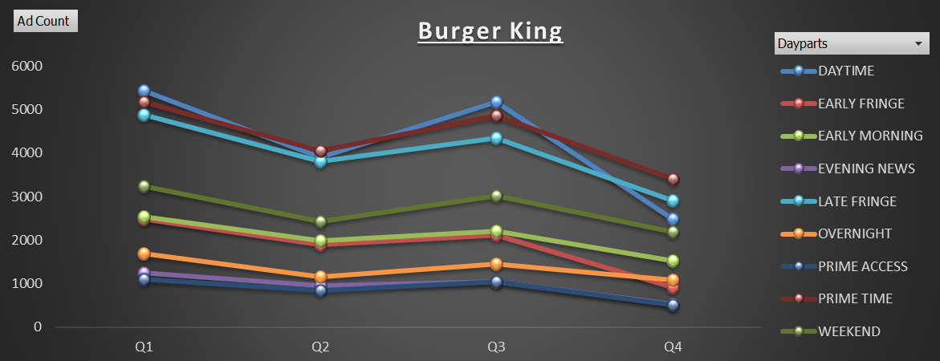
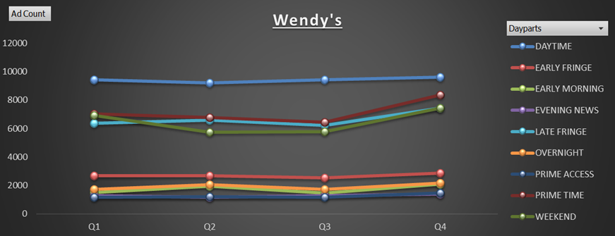
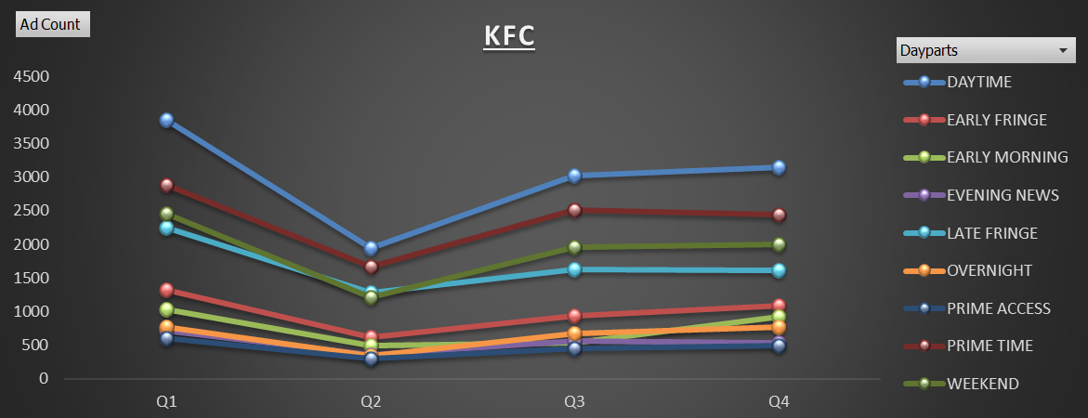
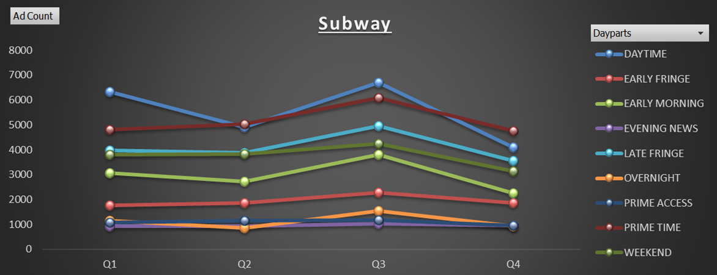
Competitive analysis for the brands and the advertisement strategy of different brands and how it differs across the brands
Count of Ads played by each brand across the parts of the day in respective quarter

Slide 5
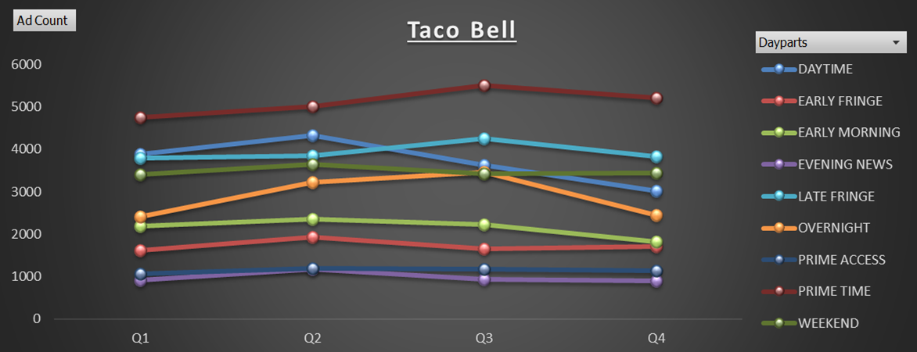
Competitive analysis for the brands and the advertisement strategy of different brands and how it differs across the brands
Count of Ads played by each brand across the parts of the day in respective quarter
% share in EQ Units for top 5 Pod positions
Except for Burger King which has highest EQ units share in 2nd Pod position, all 4 brands have highest EQ units share in 1st Pod position out of top 5 Pod position

Slide 6
Competitive analysis for the brands and the advertisement strategy of different brands and how it differs across the brands
% share in EQ Units for each brand on respective day of week
Taco Bell and Wendy’s have majority share in EQ units on Weekends
All brands have lowest share in EQ units on 1st Day of week i.e. Monday
Burger King has highest share in EQ units on Thursday and Friday, while Subway has highest share in EQ units in Sunday and KFC on Wednesday

Slide 7
Competitive analysis for the brands and the advertisement strategy of different brands and how it differs across the brands
% share in EQ Units for each brand for respective month
Burger King has major share in EQ units in January and August while Subway and Taco bell have major share in EQ units in August
Wendy’s has major share in EQ units in March, August and December
KFC has major share in EQ units in March

Slide 8
Subway wants to run a digital ad campaign to compliment its existing TV ads in Q1 of 2022. Based on the data from 2021, suggest a media plan to the CMO of Subway. Which audience should they target? *Assume LG Ads has the ad viewership data and TV viewership for the people in the US.
% share in EQ Units in Q1 for each brand
Almost all the brands have major share in EQ units in 2nd Pod Position in Q1 of 2021, thus, running the digital ad campaign in 2nd Pod would compliment the Subway’s TV ads a lot
Based on comparative analysis of all the brands, 4 out of 5 brands ran their ads in daytime part of the day in Q1 of 2021. Thus, the digital ad campaign should be run in daytime.

